Slide 1

CS 533 INTRO TO DATA SCIENCE
Michael Ekstrand

Slide 2
DISPLAYING VARIABLES

Slide 3

Learning Outcomes
Display relationships between two variables for exploratory analysis.
Extend this to more than two.
Photo by Greg Jeanneau on Unsplash

Slide 4
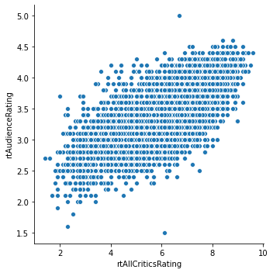
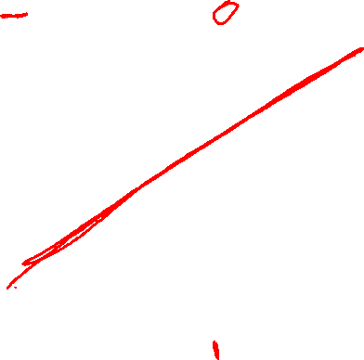
Scatterplots
Remember them?
Scatter plots show relationships between two variables:
Each point is an observation
One variable on X axis
Other on Y axis
sns.scatterplot
plt.scatter

Slide 5
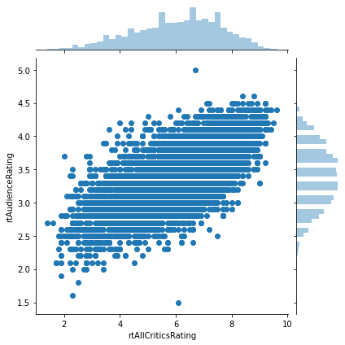

Including Distributions
Can include marginal distributions with scatter
Histograms on margins (jointplot)
“Rug plots” along axes
Useful for exploratory analysis.

Slide 6
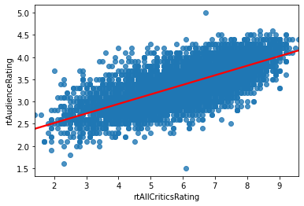
Trend Lines - regplot

Slide 7
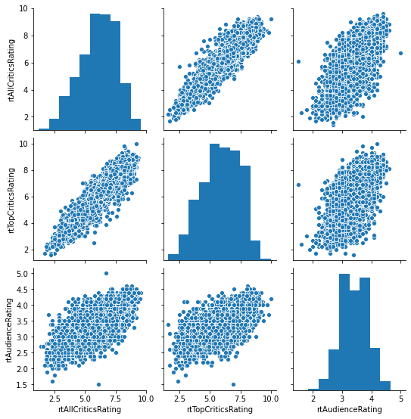
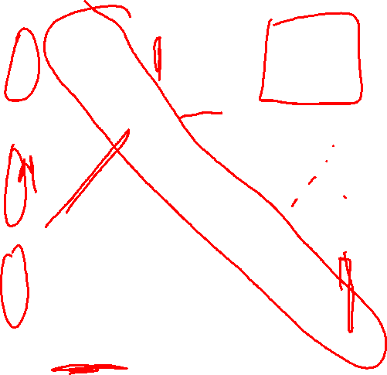
Pairwise Correlations - pairplot

Slide 8
Wrapping Up
We want to explore the relationships between variables.
Scatter plots and their variants let us do that, with possible augmentations.

